Slide 1
G.H.PATEL COLLEGE OF ENGINEERING AND TECHNOLOGY, VALLABH VIDYANAGAR(011)
Prepared by:
CHITT KAKADIA 130110120011
PUSHPAK LODALIYA 130110120020
SHIVANG PATEL 130110120040
ABHISHEK MISHRA 130110120002
ROSHAN SABHYA 130110120045
DHAVAL MODI 130110120021
Guided by:
Prof. Poorav Shah
CIVIL & STRUCTURAL ENGG DEPT

Slide 2
Road Marking
The object of Road markings is to inform, warn and to guide the road users
Road markings are in form of lines, patterns, words, symbols, reflectors applied on the pavements, Kerb, side of road way or fixed near the road way.
The markings are made using white, black, yellow paints or contrast to the colour and brightness of the pavements

Slide 3
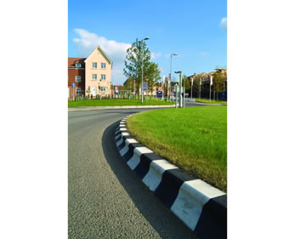
Kerb Marking
Various types of markings are

Slide 4
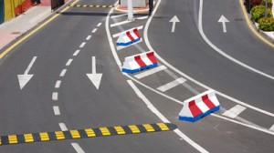
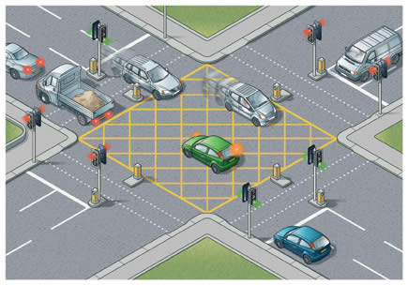
Pavement Marking

Slide 5
Object and Reflector Marking

Slide 6
Object and Reflector Marking

Slide 7
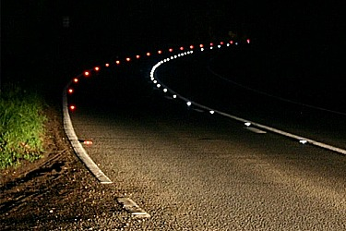
Object and Reflector Marking

Slide 8
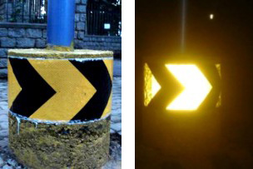
Object and Reflector Marking

Slide 9
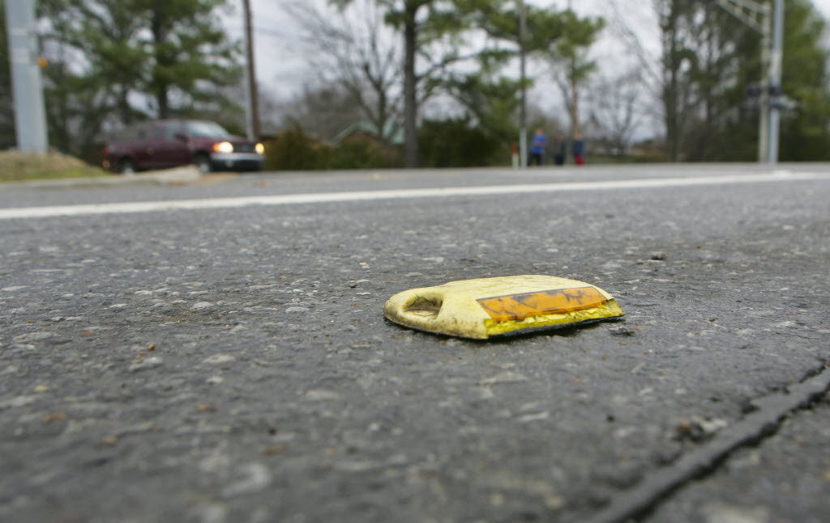
Object and Reflector Marking

Slide 10
Thank You

